Slide 1
Exploring AMERICAN HISTORY AND THE DIAMOND AS BIG AS THE RITZ
Westward Ho and The Roaring 1920s

Slide 2
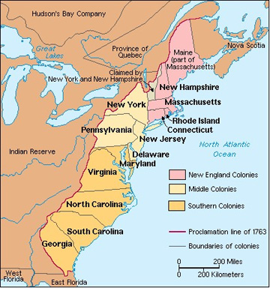
13 Original Colonies

Slide 3
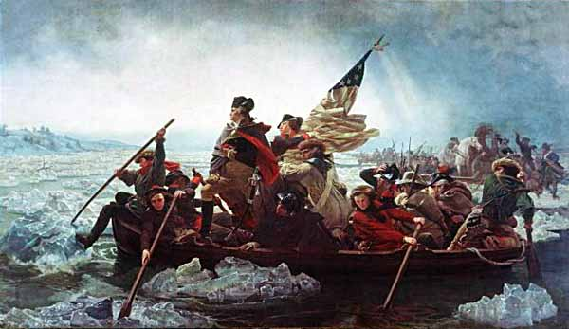
George Washington and the Revolutionary War (1775-1783)

Slide 4
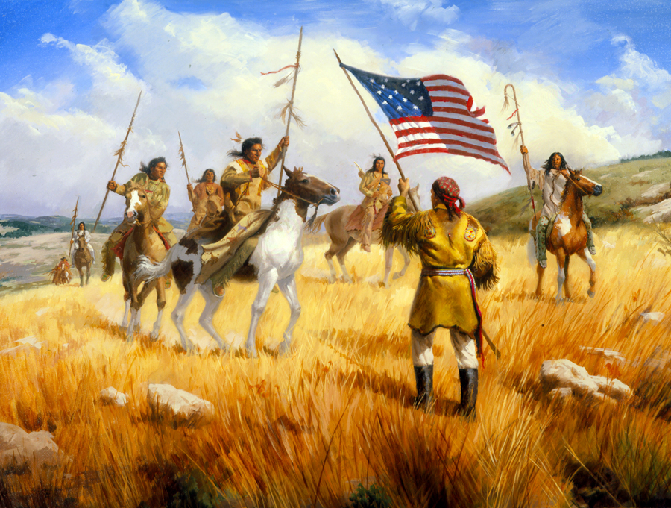
Lewis and Clark Expedition (1804-1806)

Slide 5
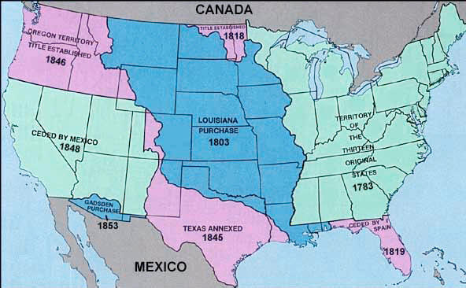
Manifest Destiny/US Expansion (early to mid 1800s)

Slide 6
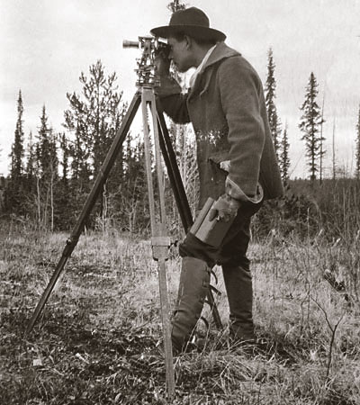
Surveying Land: Where’s Montana?

Slide 7
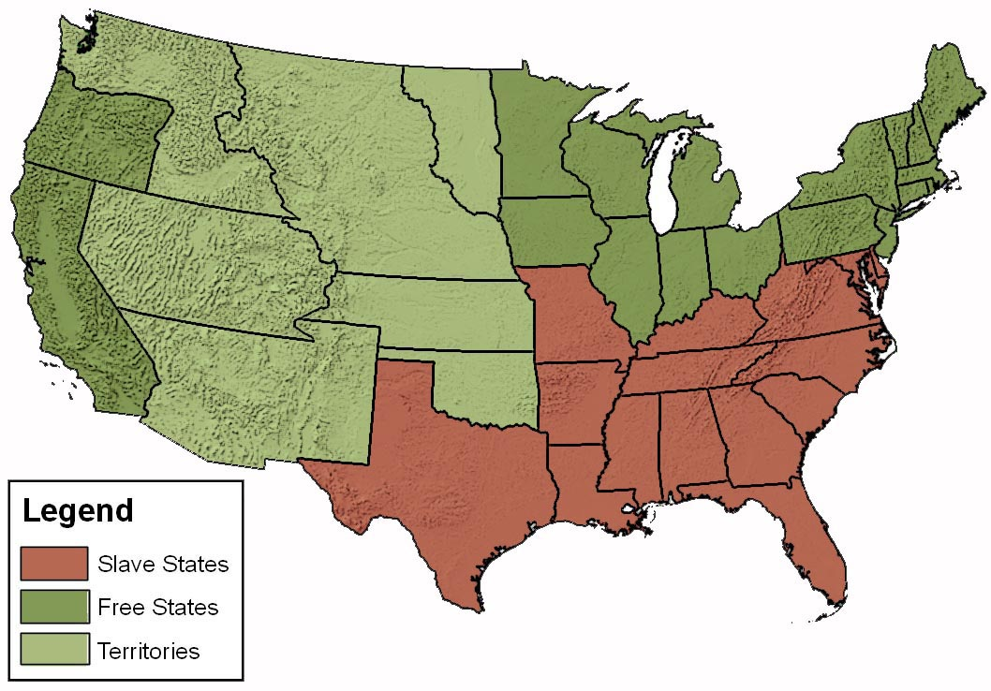
The Civil War and Questions of Slavery (1861-1865)

Slide 8
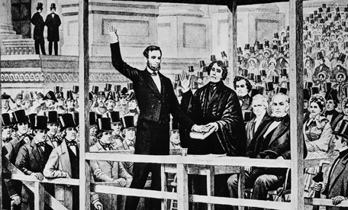
President Lincoln and the Emancipation Proclamation

Slide 9
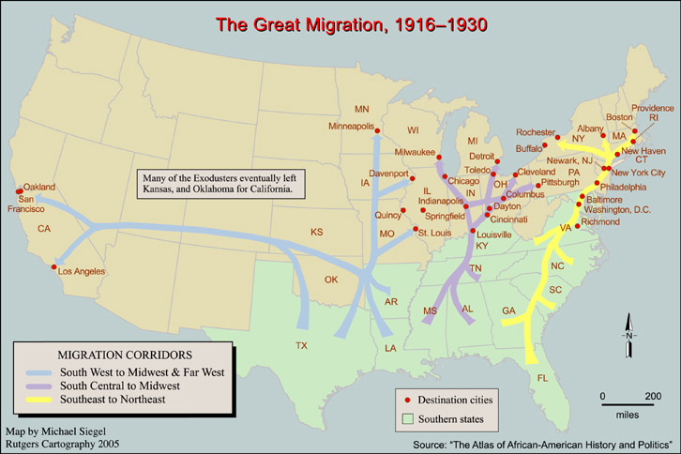
Northern Migration of African Americans

Slide 10
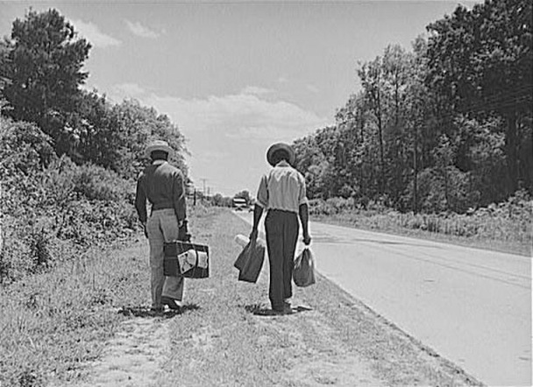
Not all Former Slaves “..worshipped their masters…”

Slide 11
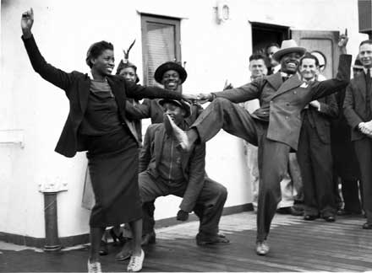
Black Cultural Contributions and Move Northwards

Slide 12
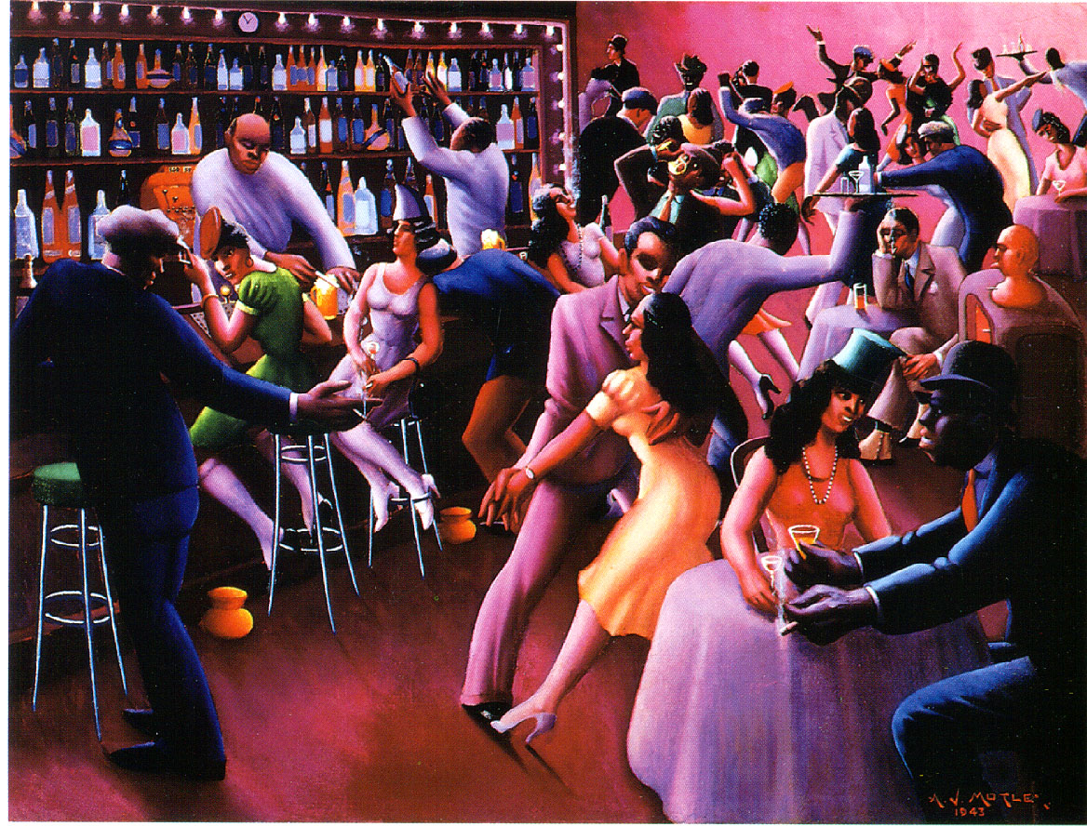
The Harlem Renaissance

Slide 13
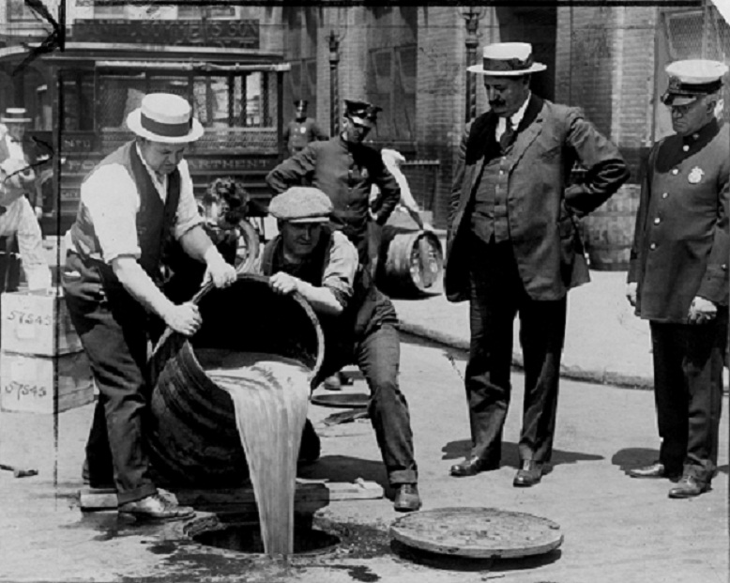
Prohibition Era

Slide 14

Emergence of Nouveau Riche, Mega-Wealthy, and Tycoon Class

Slide 15
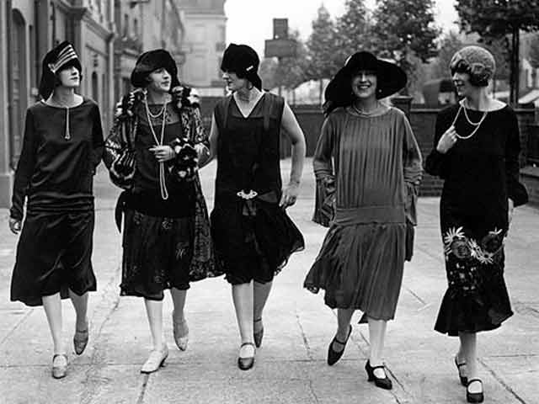
New Styles and Roles of Women: The Flapper

Slide 16
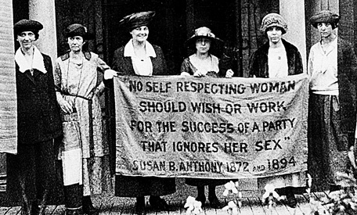
Women’s Right to Vote

Slide 17
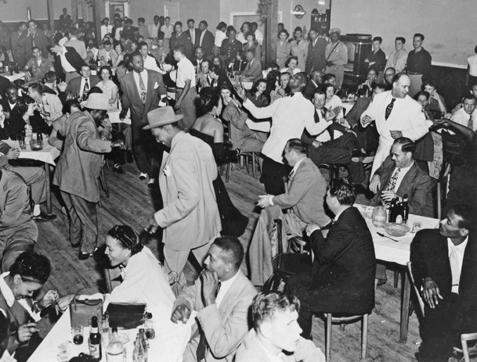
“[John] had danced all the latest dances from New York before he put on long trousers.”

